Slide 1

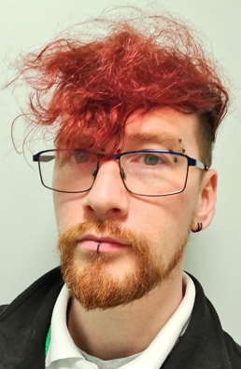
Trust Wide Champion
Christopher Dougherty
Senior Pharmacy Technician
I am a firm believer that both our work environment and the health and wellbeing of everyone working within it plays a vital role in our ability to provide safe effective health care to our patients. By fostering a working environment that is open to communication we can create a team that truly supports each other in our pursuit to provide the best health care.
Christopher.Dougherty@stockport.nhs.uk

Slide 2
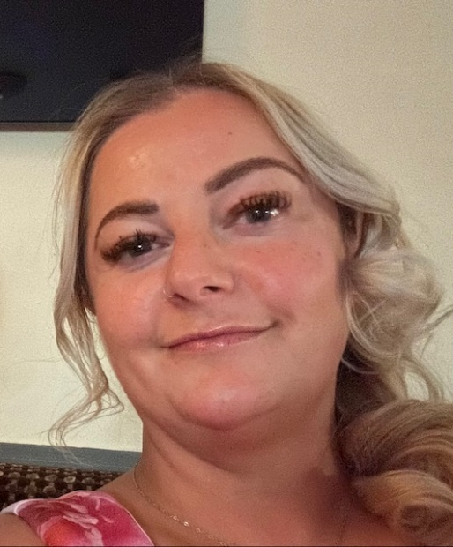
Trust Wide Champion
Victoria Rankin
Dep IT Business & Procurement Lead
I took up the role of Freedom to Speak up Champion as I believe it’s extremely important for everyone to have a voice and to feel confident in speaking up about issues that concern them. We are looking to build a positive movement and give everyone to the opportunity to feel safe, secure and comfortable in their job role.
victoria.rankin@stockport.nhs.uk

Slide 3
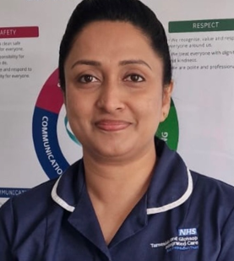
Trust Wide Champion
Sunitha Mathew
Professional Standards Practitioner
I would like to support staff to speak up when they feel that they are unable to in other ways and encourage creating a positive culture where people feel they can speak up, their voices will be heard and suggestions acted upon.
sunitha.mathew@tgh.nhs.uk

Slide 4
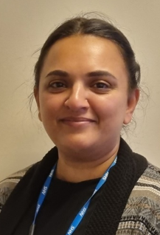
Trust Wide Champion
Fareeda Baluwala
RTT 18 Week Pathway Validator
I feel that all members of staff have the right to be listened to and feel safe to share any worries they may have in confidence. My role as a FTSU Champion will be to help give staff a safe space to talk and sign post staff to services available to them.
fareeda.baluwala@stockport.nhs.uk

Slide 5
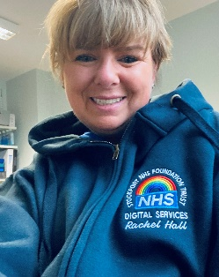
Trust Wide Champion
Rachel Hall
Digital Nurse
I am looking forward to promoting an effective freedom to speak up culture across the Trust, supporting individuals who may not feel confident in speaking up. I feel it is invaluable to foster a culture of openness, honesty and supporting the goal of a happy workplace for all staff, including external staff who visit our Trust
rachel.hall2@stockport.nhs.uk

Slide 6
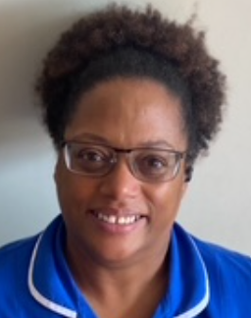
Trust Wide Champion
Ursula Richards Cairns
Clinical Education Practitioner
I became a freedom to speak up champion as I believe everyone should have a voice.
Being able to support people safely through the process can have a significant impact on staff wellbeing, safe retention and therefore an impact on patient care.
ursula.richardscairns@stockport.nhs.uk

Slide 7
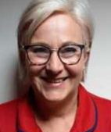
Trust Wide Champion
Jayn Seedhouse
Practice Development and Education Lead
I believe it is important that colleagues speak out so that we can improve our service, retain and support staff members, ensure patient safety and promote a culture that supports colleagues to feel valued heard and safe at work. I believe that emotional wellbeing and restorative practices are paramount to creating a safe and supportive working environment.
Nicola.Seedhouse@stockport.nhs.uk

Slide 8
Trust Wide Champion
Name
Job Tile
Your Bio Here…………………………………………………………………………………………………………………………………………………………………………………………………………………………………………………………………………………………………………………………………………………………………………………………………

Slide 9
Local Champion
Name
Job Title
Your Bio Here…………………………………………………………………………………………………………………………………………………………………………………………………………………………………………………………………………………………………………………………………………………………………………………………………

