Slide 1
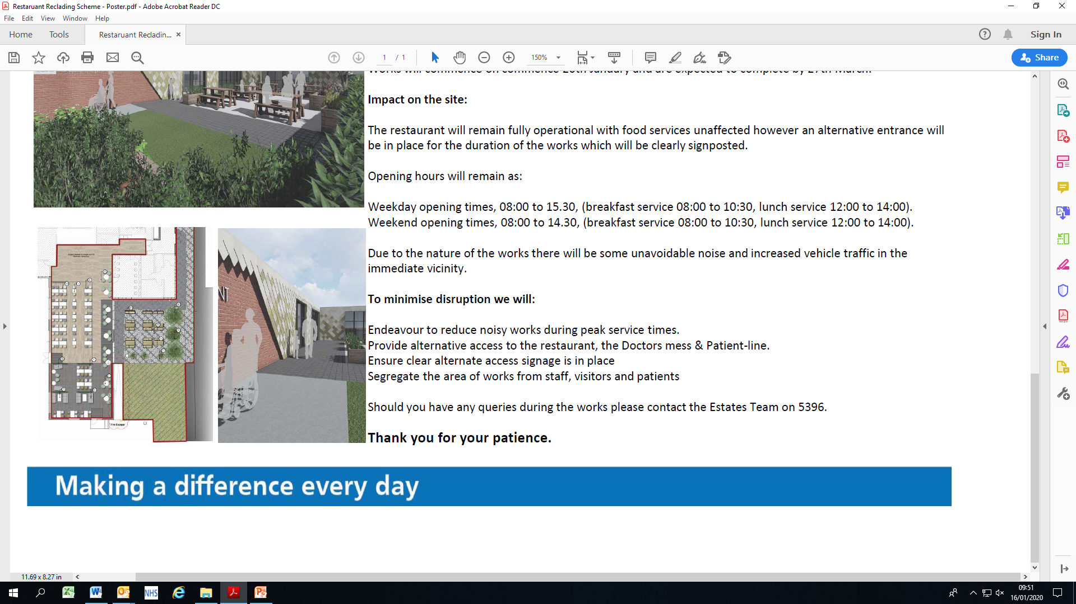
PPC Report – January 2025
Report of:
Helen Howard
Deputy Chief Nurse

Slide 2
Contents
1
1
Introduction
2
Safe Staffing
3
Workforce Safeguards
4
Guide for Safe Staffing
5
Healthroster
6
Vacancies
7
Temporary Staffing Spend
8
Agency Spend
9
Absences & Sickness
10
Risk Highlights
11
Retention
12
Reasons for Leaving
13
Recruitment
14
Training Pathways
15
Healthcare Scientists
16
Allied Health Professionals
17
Midwifery Update
18
Medical Workforce
19
20
Good News
Going Forward
t

Slide 3
1. Introduction
This report provides the Committee with an update on the following:
Staffing assurances
Current challenges regarding staffing levels and risk mitigations, and the actions being taken to mitigate risks and financial impacts identified
Safer staffing governance monitoring led by evidence-based decision-making on safe and effective staffing is a requirement for all NHS organisations
The NHS has produced a comprehensive long term workforce plan. This is a collective plan for the NHS and sets out a clear direction. The certainty of confirmed funding up to 2028 allows for actions locally, regionally and nationally to address the gaps in the current workforce and meet the challenge of a growing and ageing population
The Trust strives to provide outstanding care whilst developing flexible approaches and innovative ways of working. This is a challenging time but brings significant opportunities for workforce development
It is recognised that we are experiencing ongoing pressures require health systems and boards to make tough decisions to ensure services achieve the best outcomes at a time of financial challenge. Boards must ensure that this does not have an adverse impact on the quality of care, as well as patient, service user and staff experience

Slide 4
2. Safe Staffing
Introduction |  | What is safe staffing? What are the warnings signs of inadequate staffing? What CQC standards are around safe staffing? |  | The National Quality Board (NQB) assess Trusts’ compliance with the triangulated approach to decide staffing requirements. This combines evidence based tools, professional judgement & outcomes to ensure right staff & skills set, right place and right time.
1 Safe staffing levels How many staff do you need |  | Decide how many staff you need Plan your staffing rota Put contingencies in place Review your staffing levels Use technology to support safe staffing |  | We use strategic staffing meetings and evidence from tools such as Datix, Harms, StARS, Safe Care , Healthroster compliance & Opel level escalation processes in place.
2 Safe recruitment practices Recruit the right staff to deliver safe care & support |  | Plan your recruitment Attract the right people Review your recruitment & retention activities |  | All recruitment events are planned, organised with engagement from divisions. Attend regular Thrive workshops improve retention procedures & strategies.
3 Safe & competent staff Ensure staff are competent to deliver safe care & support |  | Give new staff a thorough induction Provide learning & development opportunities for staff Support your staff |  | Advertising for a Pastoral Care Lead. The Lead will support new staff throughout the recruitment process, on joining the Trust & induction. Robust training plans are in place for new starters. Speciality areas CPFs’ provide bespoke training.

Slide 5
3. Workforce Safeguards
To ensure the welfare & safety of staff and patient’s, nurse to patient ratios were introduced :
Deploying staff effectively
This is to advise the Committee of their responsibilities in ensuring staffing arrangements are safe, sustainable and productive. It also considers emerging roles such as nursing associates (NAs), physician associates and Advanced Clinical Practitioners (ACP) who are all integral to the future NHS workforce.
Useful guidance
The National Quality Board’s (NQB) guidance explicitly requires the Trust meets the following expectations :
deploying the right staff
with the right skills
at the right place and time
These set the foundations on which any workforce plan should be based while not ignoring other organisational development needs such as values and behaviours.
In addition, the Cavendish Report 4 highlights that well-performing organisations use their workforce as a strategic asset. This underlines the need to deploy the workforce effectively and efficiently.

Slide 6
4. Guide for safe staffing
A good rota assists staff in planning work-life balance, communicating with colleagues and people who need care and support. And provides evidence for the CQC inspection
Once built the rota is approved 12 weeks in advance, this supports the staff with their work-life balance as they can request preferred pattern of shifts
It is expected, where possible, staff schedule non-emergency appointments on days off. Staff can view shifts & request annual leave via Loop, this app can also be downloaded onto a mobile phone providing flexibility regarding planning annual leave while off-site
Senior members of staff are allocated to build safe and efficient rotas.
Staff creating rotas require an understanding of the financial impact and skillset of the workforce required
Managers are expected to monitor the rota regularly and input changes such as sickness, annual leave, study days
Healthroster is discussed at ward/unit meetings, managers proactively engage and act on staff feedback in making improvements in the building of the roster.
The electronic system is simple to use with regular training for all staff groups.

Slide 7
5. Healthroster
The Trust uses Safecare Live at the twice daily staffing meetings to review staffing levels in conjunction with the acuity levels of patients.
The recently introduced Rostering dashboard provides trend data for the Key Performance Indicators (KPIs) which can be used as evidence in report/requests for data. From the information it has been reported
Safecare Statistics have increased month on month & currently at 68.21% for the Trust. Seventeen areas have increased the % compliance over the past 3 months
Rosters are approved on average 63 days ahead of the roster commencing
Total unavailability has reduced to 20.5% bringing this in line with the KPIs target
Changes to rosters since approval have reduced to 26.5%. The E-rostering Team will focus on identifying a strategy to reduce this
Data provided by the Rostering Team

Slide 8
6. Vacancies
The data below covers the positions of registered nurses (RNs), registered midwives (RMs), nursing associates (NAs), newly registered nurses and midwives awaiting PINs.
Registered Nurses & Midwives | FTE Actual | Variance FTE | Post Recruited to in TRAC FTE & awaiting start dates
Clinical Support Services | 59.73 | 2.74 | 2
Corporate Services | 105.89 | 8.69 | 19
Integrated Care | 255.38 | -23.36 | 27
Medicine & Urgent Care | 520.66 | -82.84 | 59
Surgery | 476.65 | -26.86 | 28
Women & Children’s | 402.33 | -24.15 | 29
Total | 1,820.64 | -145.78 | 164
In November 2025, 164 WTE successful candidates were in the recruitment process & awaiting start dates.
The process for recruiting nursing students has been agreed by all the Divisional Nursing Directors (DNDs), Head of Learning & Education and Workforce, and will be presented to the Nursing, Midwifery & AHP (Allied Health Professionals) Meeting in January for final approval. The SOP aims to ensure nursing students are supported throughout their interview and appointment, HR recruitment process, induction and as they transfer from learner to practitioner. This process will be led by the new role of Pastoral Care Lead & Matron for Workforce in collaboration with the Learning and Education Team.
Data provided by Workforce

Slide 9
7. Temporary Staffing Spend
The table below illustrates the ‘month on month’ cost to the Trust of NHSP bank RNs, RMs and unregistered staff.
Data provided by People Analytics

Slide 10
8. Agency Spend
The Deputy Chief Nurse, DNDs and NHSP attend a weekly meeting to review agency uptake and explore strategies to reduce agency usage. Staff are encouraged to put out bank shifts as soon as possible to ensure early pick-up, and the Trust is now working towards reducing the cascade to 12 hours.
This has all contributed to a dramatic reduction in agency spend from July to November.
Data provided by NHS Professionals

Slide 11
9. Absences/Sickness
The chart below illustrates the absence rates for registered nurses, registered midwifes and AHPs.
An absence from work can be the result of many factors for example short-term sickness due to colds/virus, long term condition, carers leave and it is recognised that the highest absence rates are during school holidays. ‘Looking after our people’ NHS People Plan. The Trust absence target is set at 6%.
Role | Sickness %
AHPs | 4.52%
RNs & RMs | 6.64%
The main reasons for absence continues to be Anxiety, Stress & Depression
The Trust has a close working relationship with HR, Occupational Health, Professional Nurse Advocates (PNA) SPAWS & Freedom to Speak Up Champions to support the work life balance of our employees
Data provided by People Analytics & Workforce

Slide 12
10. Risk Highlights
The Trust actively encourages all employees to report incidents of staffing shortfalls.
There was a significant reduction in the number of incidents from October to November evidence that the Trust has a robust staffing infrastructure as fewer incidents occurred. This provides reassurance with the onset of winter pressures.
Data provided by Datix

Slide 13
11. Retention
The chart below illustrates the Trust’s staff retention rate ‘month on month’ from November 2023 – November 2024.
There has been a gradually improvement in retention over the last few months & matches where the Trust was 12 months ago. It is anticipated that this trend will continue with the introduction of the new role of Pastoral Care Lead who will focus on supporting new starters from interview through the recruitment process, and their induction. The Trust values career development and invests in staff by providing training opportunities and supporting secondments to enhance career development. This encompasses both the NHS People Plan and People Promise.
Data provided by People Analytics

Slide 14
12. Reasons for Leaving – November 2024
There has been an increase in staff applying for voluntary redundancy & focusing on a healthy work/life balance
Data provided by People Analytics

Slide 15
13. Recruitment
HCA Recruitment Event took place in November 2024 with great support from all divisions, HR & the Training Department which resulted in successfully appointing 107 candidates
‘New Year, New Job’ recruitment event for RNs & HCAs scheduled for the 25th January

Slide 16

14. Training Pathways
Multi-Professional Cadet Programme
We have successfully expanded the Cadet Programme for 2024/25
The following numbers are confirmed with Stockport and Cheadle Group :
20 2nd year cadets returning from last year
58 1st years – both groups complete 1 day per week over 2 years
30 transitional year cadets from Cheadle site (complete one week placement x 3 per year)
20 transitional year cadets from the Marple site
6 cadets from Macclesfield College and an additional 8 in January 2025
40 cadets from The Manchester College
In total, we are expecting around 190-200 cadets on placement this academic year, including students on T-Levels, Btec, Cache and Level 2 Transition programmes.
16 adult learners from UCEN were successfully recruited into HCA positions following the November 2024 Recruitment Event.
Placement expansion and relationship building continues in Place-Based environments and we are liaising closely with the GM and ICB Workforce Development Lead, One Stockport and other external partners.
Two cadets from the last cohort have secured employment within nursing homes recently opened for placements and 2 cadets have also secured HCA positions within the Acute Trust.
We are working with GM universities to secure interviews and “home Trust” placements for those wishing to pursue a Nursing Degree to retain young people in Stockport.
We will continue to monitor, document and report on cadet destinations.
Information provided by the Learning & Development Department

Slide 17
15. Healthcare Scientists
Laboratory Medical
Microbiology consultants remain the largest risk following 2 retirements without being able to recruit to the posts. Current mitigation is recruitment of 2.6 WTE speciality doctors and 1 locum consultant. The consultant on sabbatical has returned. Support from Manchester Foundation Trust (MFT) has been received to cover the on-call provision. A consultant clinical scientist has been interviewed, and we will be moving to appoint. NHSP and ID-medical are engaged for continued recruitment support.
Histopathology consultant workforce is stable with 11 consultants. The reporting of the service is still supported with outsourcing to a private company.
Blood sciences there is an additional day to backfill consultant clinical scientist to provide capacity for the replacement LIMS project. There has been no additional resource for the significant increase in workload seen since Covid, with yearly increases above 10% growth. Growth continues at 6% year to date, and no additional resource has been provided.
Histology Laboratory
Biomedical Scientists (BMS) We remain 2 BMS short of the required staffing to match the workload coming to the lab, locums have been required to match this however they are not a stable resource with repeated recruitment needed. Internal training to Band 6 for 3 staff continues as the lack of Band 6 staff in the recruitment market remains.
Medical Laboratory Assistants (MLA) – Cancer Tracker post has been offered and is in the recruitment process. Staffing numbers are below that required as highlighted in the paper to executives and an increase in establishment is required.
Data provided
Data provided by Pathology

Slide 18
15. Healthcare Scientists
Blood sciences
Biomedical Scientists (BMS), Bands 5-8s Recruited staff are moving onto the on-call rota and this is improving the resilience of the service. There is a requirement for support from the staff in terms of overtime to cover the transition to the new analytical platforms and operating without robotics in place.
Medical Laboratory Assistants (MLA), Bands 2-4 A new supervisor has been appointed in the Blood Sciences Reception and has started in role. Additional staffing will be required whilst the Blood Sciences Analysers and automation is replaced as there will be no automation support for this period. There is a historically a high turnover for the MLA staff in the Pathology Reception and this is seen to be continuing. This is due to it being a stepping stone entry position within laboratory services.
Microbiology Laboratory
Biomedical Scientists (BMS), Bands 5-8s the Laboratory Technical Head has returned from maternity leave. There is a lack of sufficient staff in this area, though recruited to establishment and this is a pressure point as microbiology remains a very manual process.
Medical Laboratory Assistants (MLA), Bands 2-4 Workload against staffing level is a significant pressure for this group.
Summary
Pathology has seen a year-on-year workload increase between 6-10% across the disciplines far exceeding the annual growth prior to Covid & has past the point of saturation of the staffing resource. A business case has been submitted for an increase in staffing. This has been agreed in principle, but funding is yet to be sourced.
Recruitment remains an obstacle for experienced BMS staff and in-house training has been required to bring people to qualification and through their specialist portfolios.
Data provided
Data provided by Pathology

Slide 19
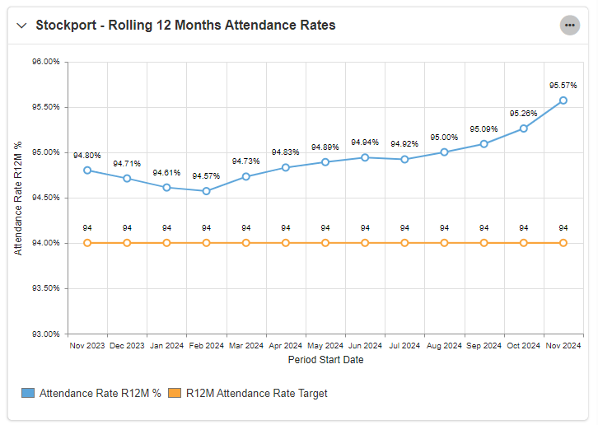
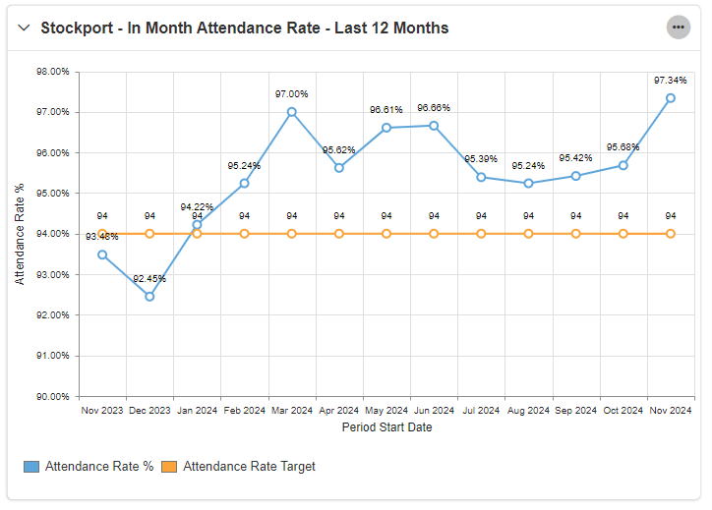
16. Allied Health Professionals (AHPs) – Integrated Therapies
Attendance Rates
The Directorate is extremely proud to report further progress with in-month & rolling 12-month attendance rates, as shown in the graphs below, particularly given the seasonal dip last year. In September it was reported that anxiety/stress/depression was the most prevalent category, but it now sits at 4th, with both cough/cold/flu & gastro both sitting above it at the time of writing. There has been a local drive for both flu & COVID vaccine take-up, with 2 department vaccine clinics set up in Inpatient Therapies to support attendance.
Metrics are closely monitored at team level to ensure any exceptions are identified, with deep dives & relevant action plans presented at the monthly Directorate Quality & Performance meetings, with escalation to divisional level when appropriate.
Data provided by Integrated Therapies & Boroughwide Services

Slide 20
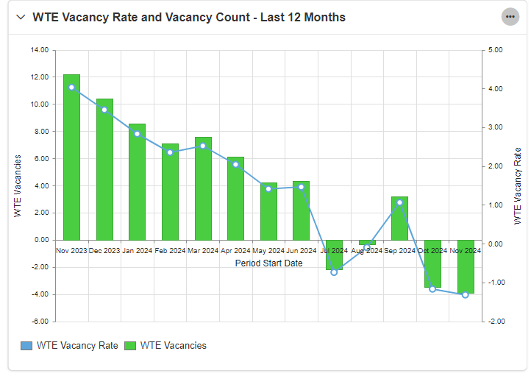
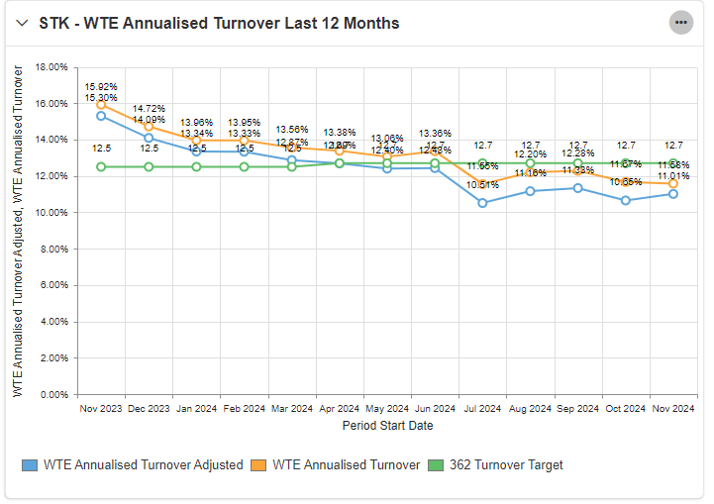
16. Allied Health Professionals (AHPs) – Integrated Therapies
Integrated Therapies Staffing
As a directorate, we are cognisant that we currently have a team of Apprentice AHPs without substantive funding, after the Trust’s agreement to use turnover & non-recurrent vacancy factor. This is important when looking at number of vacant posts as the additional staffing can mask substantive vacancies. However, looking at the November data the true vacancy count is circa 4.7 WTE. The graph to the right illustrates staffing is currently in the best position for over 12 months. Integrated Therapies are currently working with Medicine to review Stroke staffing against the RCP guidelines which will be presented in the New Year.
Turnover
November was the 8th consecutive month with adjusted turnover lower than the 12.7% target. Most leavers cited promotional opportunity as the reason for leaving & this accounted for 21.3% of the series. This is reassuring as we take career development seriously & is a testament that our workforce, in the main, are leaving their posts for positive reasons. However, in November, 9 leavers (14.8%) cited work/life balance. In the new year, a deep dive will commence to understand the nuance of this & identify any opportunities to address or improve this statistic.
Data provided
Data provided by Integrated Therapies & Boroughwide Services

Slide 21
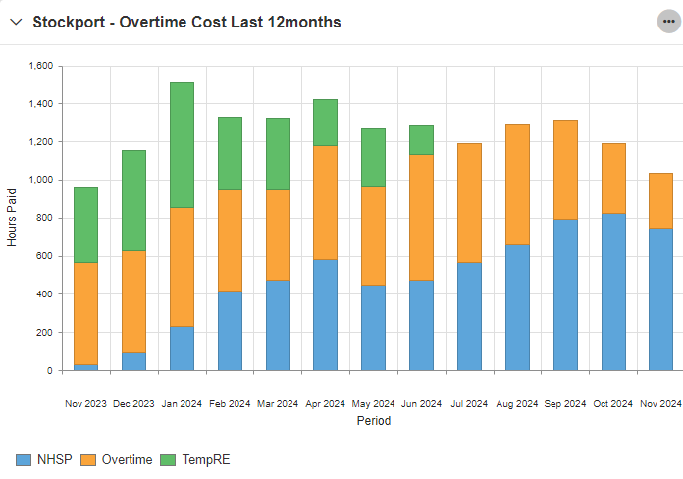
16. Allied Health Professionals (AHPs) – Integrated Therapies
Apprenticeships
We have successfully appointed to 4 of the 5 Support Worker apprenticeships for 2024/25. Our Level 3 apprentice started in November & our Level 5 apprentices will start their programme in February. All Level 6 apprentices remain on the programme & are progressing well.
Temporary Staffing
As discussed in the last paper, temporary staffing & overtime costs have been areas of focus for Integrated Therapies. We continue to staff one ward (historic escalation ward) through NHSP, using bank to support with vacancies (AHP services do not use temporary staffing to support unplanned leave). The process for approving additional hours has been reviewed & updated, with added rigor & standardisation. As a result, we have seen hours paid & the proportion of ‘additional hours/overtime’ reduced to the lowest level since December 2023, which is the timeframe available for review (see graph below). Focus on this will continue in 2025 & we are reviewing our weekend rosters & operational deployment to identify any further potential efficiencies.
Health Roster
Work is ongoing to move AHPs forwards with regards to Heath Roster KPI compliance and effectiveness. Several processes have been updated, including a review & tidy of roster tiles, all weekend/on-call services now having standalone rosters, and a clear expectation of the 70 day approval lead time.
Data provided
Data provided by Integrated Therapies & Boroughwide Services

Slide 22
17. Midwifery Update
The Maternity Unit is currently staffed in line with NICE guidance for Safe Midwifery Staffing for Maternity Settings (NICE 2015) and the latest Birth Rate plus (BR+) midwifery staffing review (March 2023).
Challenges
Current registered vacancy inclusive of inpatient & outpatient areas is 5.88 WTE with a gap of 8 WTE on maternity leave. This equates to a total deficit of 13.88 WTE & 1.48 WTE of notices. At a total of 15.36 WTE.
Maternity Support Worker (MSW) 5.65 WTE vacancy and maternity leave 0.88 WTE. This equates to 6.53 WTE
Actions
Weekly planned roster scrutiny meetings/E-Roster training sessions continue
Recruitment event held in April 2024 – 15.24 WTE offers made, 12.68 WTE accepted & onboarding in process
Awaiting external approval to send offers to midwives currently in Trac reserve
Assurance
All shift co-ordinators have supernumerary status &
monitored daily by MOD, incorporated into monthly
dashboard with 100% compliance September 2024
August 2024 showed 99.2% one-to-one care in labour
(1 fully dilated on arrival)
Fully engaged with MSW Framework Working Group
We have commenced trust pre-employment
programme for HCAs
Registered Midwives
WTE Actual | WTE Vacancies | Post WTE Recruited to TRAC
162.2 | No vacancies Mat Leave 10.6 | 4.76 NQM start dates tbc 1 Band 6 midwife start date confirmed
Data provided by the Division of Women & Children’s

Slide 23
18. Medical Workforce
The Tiers below describe the directly employed Medical Workforce within the Trust:
Tier 3: Expert clinical decision makers These are clinicians with overall responsibility for patient care. In the Medical Workforce these are our Consultants.
Tier 2: Senior clinical decision makers These are clinicians capable of making a prompt clinical diagnosis and deciding the need for specific investigations and treatment. For the medical grades this is largely SAS Doctors and Senior Clinical Fellows.
Tier 1: Competent clinical decision makers These are clinicians capable of making an initial assessment of a patient. For the medical grades this is largely Foundation Doctors and Junior Clinical Fellows.
N.B. The Trust is also a host employer on behalf of the Lead Employer, St Helens and Knowsley NHS Trust, for specialty, core and general practice trainees and we host a further 165 trainee doctors working at the Trust across our specialties.
Medical Staff | FTE Budgeted | FTE Actual
Tier 3 | 257.01 | 238.11
Tier 2 | 150.21 | 125.8
Tier 1 | 139.18 | 154.2
Total | 546.40 | 518.11
Data provided by Medical Staffing

Slide 24
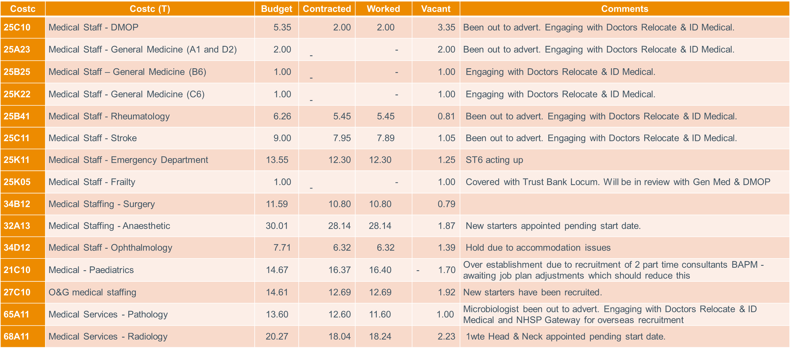
18. Medical Workforce
Consultant Vacancies
The table below gives an overview of the vacancies :
Data provided by Medical Staffing

Slide 25
18. Medical Workforce
Medical Workforce Group General Update
Senior Medical Recruitment
This is monitored by the Medical Workforce Group & seeks to assist divisions with e.g. those difficult to fill specialties and ensure that all options are being explored.
*There have been a number of positive appointments recently including in Urology, Radiology & Anaesthetics.
Senior Medical Locum Expenditure
This is also being monitored by the Group so that it can actively seek to assist divisions in reducing costs whilst also focusing on ensuring ensure safe staffing levels and patient safety. This exercise has already demonstrated significant financial savings and cost avoidance for the Trust.
GMC Survey and Mandatory Training
The Group have placed great emphasis on improving the GMC Survey Results & mandatory training compliance rates in 2024. There has been improvements in both areas & will help with attracting doctors to the Trust.
N.B. Likewise, the Trust has now moved to the top 20% of regional trusts for mandatory training compliance for Lead Employer doctors.
Portfolio Pathway and Workforce Planning
The group have undertaken research into the type of support which can be provided to Doctors wanting to undertake CESR & ultimately eligible for Consultant posts to help with workforce planning, particularly in those difficult to fill areas. A revised paper will be presented to the Group in January & then forwarded to the Trust Executives, giving recommendations on next steps.
Data provided by Medical Staffing

Slide 26
18. Medical Workforce
Engagement with external agencies
Discussions with NHSP Gateway to seek ‘net new’ doctors to the UK & NHS with Portfolio Pathway support with Speciality Doctor / Specialist roles back in July 2024. MOU has been signed off. Waiting for CVs for Microbiology once passed their MAG assessment process. Department engaged & looking at our ‘offer’ in terms of relocation package & RRP.
Actively engaging with ID Medical & Doctors Relocate under NHS Framework – specifically within Medicine & Microbiology to identify UK based doctors. Pulse have also been supporting Microbiology & provided a suitable doctor, unfortunately the doctor had already accepted another appointment.
To date 21 CVs have been shared for potential Consultant vacancies from ID Medical & Doctors Relocate. Only 2 appropriate candidates for General Medicine. Unfortunately, these will not be going ahead due to a pending review of General Medicine job plans. The remainder of applicants did not have the required level of experience or passed their MRCP exams.
Medicine have appointed 2 SCFs from ID Medical. They could however have been filled without using ID Medical as there was adequate applications via Trac but were advised to interview those sent by ID Medical alongside the Trac applications. Consequently, this has resulted in the additional cost of the ID Medical’s finders’ fee.
Data provided by Medical Staffing

Slide 27
Nursing and Midwifery Recruitment and Retention
19. Good news
Continuing to work with NHSP to create a pathway enabling NHSP HCAs to apply directly to vacancies within the Trust, this ensures a quicker more efficient recruitment process
Two members of staff have started the PNA (Professional Nurse Advocate) programme & will be qualifying at the end of January
NHSE GIRFT Lead for Theatres to use the Trust’s Theatres staffing structure for a pilot in developing Scrub Practitioners
As a result of a highly successful HCA Recruitment Event in November 2024, the 107 successful candidates are currently in the recruitment process & awaiting confirmation of start dates
There has been a steady reduction in the use of agency from 10.1% in July to 5.8% in November
There are currently no vacancies in Midwifery. 4.76 WTE newly qualified midwives start dates have been confirmed & 1 Band 6 start date to be confirmed
NHSE conducted a nursing, midwifery and AHP workforce review during November with feedback around many of our “brilliant” and innovative practices. We await the formal feedback report.

Slide 28
20. Going forward
There has been a steady reduction in
agency usage since July, and this is expected
to continue with the implementation of
effective initiatives to ensure cost savings :
107 candidates were successfully appointed at the HCA Recruitment Event in November 2024 & have been allocated to clinical areas. Due to the high number the Training Department have reviewed the Care Certificate programme to ensure the new starters complete the training & competencies as soon as possible
The Emergency Department have developed a Development Transformation Programme which will provide support & training for Band 5s career progression to a Band 6
Surgery & Medicine have developed a career development programme for Trust Band 2 HCAs to upskill to a Band 3. Clinical skills training will be provided by the Training Department

