Slide 1
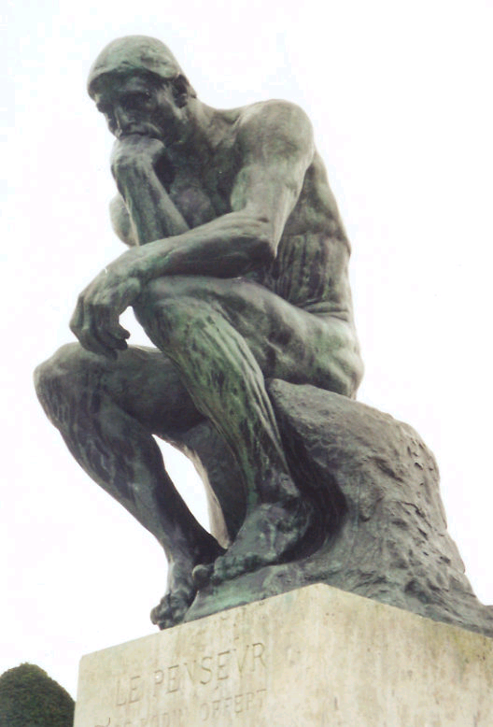
Reflection and Reflective Practice
Notes:
JEAN

Slide 2
Aim of the session
To understand how reflection can develop and improve practice and how it applies to mentoring students

Slide 3
Learning Outcomes
To know what is reflective practice
Examine the process of reflection
Identify different models of reflection
How reflection relates to the portfolio content for MSLAP

Slide 4
How this session relates to your portfolio of evidence
Provide an analysis on reflective models, identify a model of reflection which you may wish to use throughout the portfolio and justify your choice
Include :-
a definition for reflection
choose a couple of models and compare and contrast these
explain the benefits of reflective practice
This piece of work needs to be a minimum 500 words and referenced.
This piece of work should demonstrate evidence of reading, application of theory & understanding of the principles. (HE5 level and referenced

Slide 5
Cont.
At the end of the course reflect on your role as a developing mentor/ educator/assessor, include the skills you have developed and how you will maintain your professional development in this role.
Reflect on an assessment of a student’s competence that you have undertaken. This may be a practical skill or a learning objective from their practice assessment document . Evaluate how you gave feedback to the student on their abilities.

Slide 6
What is Reflective Practice?
Bridges between theory and direct practice
Concept introduced in 1980’s according to Jasper 2003
Roots in education
“A window through which the practitioner can view and focus self within the context of her own experiences in ways that enable her to confront, understand and work towards resolving the contradictions within her practice between what is desirable and actual practice” (Johns 2000 p 34)

Slide 7
Why Reflect?
Jasper suggests our very own personal safety
Self Development
Self Awareness
Identifying opportunities
To empower and emancipate
To develop strategies

Slide 8
When should we use reflection in the workplace?
Should be a daily event
When working with service users
during and after our meetings
When we are involved in training
supervision
When times are good
when days are bad

Slide 9
Schon’s ideas on reflection
“Reflection is a way of thinking and learning”
Reflection in action
Reflection on action
-Schon, D (1995) The Reflective Practitioner. San Francisco, CA: Jossey-Bass.

Slide 10
Reflection in action
On line thinking
Spontaneous
Drawing on an individuals experience “ When a practitioner makes sense of a situation he perceives to be unique, he sees it in something already present in his repertoire”(Schonn 1987 p 67)
Problem solving
Reservoir of knowledge

Slide 11
Reflection on Action
Off line thinking
looking back at the event
evaluation
Retrospective

Slide 12
Activity
Divide your selves into groups .
Take one of the articles describing each reflective model
In your group looks at:-
The structure of the model
Think of advantages / disadvantages of your model.
Feedback this information to the other groups.
Write up words and phrases that relate to Reflection and reflective practice?
How can reflection be useful?
What are the benefits of reflecting on our own practice?

Slide 13
For the portfolio
Discuss what is good about reflection and its effects on practice?
Why is it important for you as a practitioner and the patients?
Does it have critics ? Look at the literature for this
Define reflection use literature to find a quote or definition from a respectable source
Identify 2 or 3 different models of reflection eg Gibbs, Johns, Schon etc….
Think about a model you could use on a regular basis and say why you prefer that model to others. Is it cause its straight forward , do you like how it guides you through the process, that it addresses how you feel etc…
Use Harvard to reference any sources you have used in this piece

Slide 14
Useful link
http://www.coloradonursingcenter.org/documents/clinical%20scholar/Resources/Reflective%20Practice.pdf

Slide 15
Bibliography
Hayfron-Benjamin,M. (none available). Guidance on Reflective Writing. Available: http://qmplus.qmul.ac.uk/mod/book/view.php?id=257889. Last accessed 30th September 2014
Jasper M (2003). Beginning Reflective Practice. Cheltenham: Nelson Thornes.
Ruth-Sahd, L.A. (2003). Reflective Practice: A Critical Analysis of Data-Based Studies and Implications for Nursing Education. Available: http://www.coloradonursingcenter.org/documents/clinical%20scholar/Resources/Reflective%20Practice.pdf. Last accessed 30th September 2014.

Slide 16
Micro teaching session
Split into groups of 3 Teacher, Learner, Observer
5 Minute teaching session (Absolutely anything) and 5 minutes to reflect and feedback
Roles
Teacher : consider what methods you will use to carry out the session. How will you evaluate the succses of your session
Learner: Provide feedback to the teacher. What worked well for you? What worked not so well? Did you learn what was intended
Observer: Look at the dynamics of the session and provide feedback on the overall session. Was it clear what was being taught? Was the pace and delivery appropriate? Was the assessment valid?
Notes:
Jean

Slide 17
Principles of teaching a skill
Initial demonstration (step by step)
Break down into components ( hierarchy of sequence)
Skill acquisition – supervised , reinforced , repetition
Swift and accurate feedback
Regular assessment of skill
Achievement of competence at first level before moving on to next (Curzon 2003)
Notes:
Jean

Slide 18
Preparing learning: As mentors/ educators you need to:-
Know the learners and how they learn
Ensure you have time to spend with them
Understand what motivates them
Plan with the student
Involve the student in the process
Use a variety of methods , approaches and techniques that suit the individual. Play to the learners strengths.
Make things relevant
Understand the learning outcomes and how you will get there
Offer formative, timely feedback and guidance
Notes:
JEAN

Slide 19
Quiz
According to Phil Race what 5 factors make learning happen?
Name 3 of the theories we have looked at in relation to teaching and learning?
What does Andragogy refer to ?
Who developed a cycle of experiential learning?
What are the four learning styles developed by Honey and Mumford (1982)?
Notes:
JEAN
1Wanting to learn (intrinsic motivation)
Needing to learn (extrinsic motivation)
Learning by doing (experiential learning)
Feedback
Making sense of things (Digesting information)
2 Behaviourism
Humanist
Constructivism
Cognitivism
Social learning theory
3Adult learning
4 Kolb
5 Activist
Theorist
Pragmatist
Reflector
6 Visual
Auditory
Kinaesthetic
7 Meta cognitive
8 Cognitive
Affective
Psycomotor

Slide 20
To Summarise We have:
Defined the differences between learning, teaching and mentorship.
Examined research into successful and unsuccessful learning.
Looked at some of the theories that underpin learning.
Discussed learning styles.
Noted the nature of holism in our approach to students.
Looked at how we can deliver a micro teaching session and gained feedback from others
Notes:
JEAN

