Slide 1
10 Year Health Plan
Have your say

Slide 2
Secretary of State Video

Slide 3
The NHS has been there for us for over 76 years. But to make sure it’s here for the next 76 years, doing all it can to support the health of everyone, we need your help.
NHS England have launched Change NHS to hear your views, experiences, and ideas which will shape a new 10 Year Health Plan for England.
They are asking for feedback from our area by Thursday 13th February 2025.

Slide 4
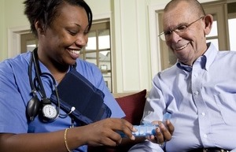
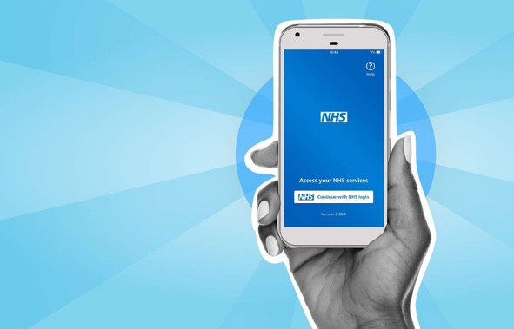
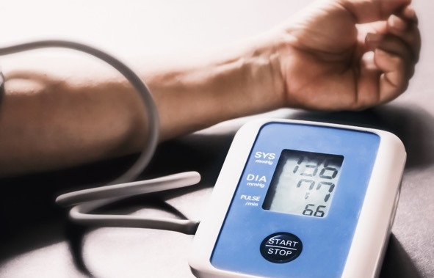
The 10 Year Health Plan will be built around 3 shifts:
Information
These changes will be the focus of our conversation today
Moving more care from hospitals to communities
Making better use of technology
Preventing sickness, not just treating it
Moving care from hospitals into homes, closer to the places people live and their community.
Using digital technology promises faster, higher-quality, more connected care.
Preventing rather than simply treating sickness will keep people healthier for longer.

Slide 5
What is this all about?
Information
Our NHS is facing challenges and needs to change to make sure health and care services are fit for the future.
But to fix health and care services, the Government needs to learn from your experiences and hear your ideas.
Your views, experiences and ideas will shape immediate steps and long-term changes in a new 10 Year Health Plan.

Slide 6
Some actions have already been announced….
Information
The biggest increase in funding for the NHS since 2010
More GP appointments
Investment for scanners
Resolving the resident doctor strikes

Slide 7
Our conversation is part of a process to work with the public and staff to fix the NHS
Information
The Department of Health and Social Care and NHS England are developing the 10 Year Health Plan together with the public and health and care staff.
Over the next few months there will be lots of conversations happening across England.
These conversations will include people from all backgrounds and with lots of different experiences, as well as different types of health and care staff.
The views and experiences that you share today will be brought together with what people say at other events and used to shape the 10 Year Health Plan.

Slide 8
Making better use of technology

Slide 9
Making better use of technology in health and care
Information
What is the challenge?
What might this include?
What impact might it have?
Some parts of the NHS still rely on paper and pagers, slow computers and outdated software
Slow and uneven use of new technology means access to the latest treatments often depends on where you live
Keeping talented staff is difficult without the technology they need
Investing in digital technology such as imaging machines and scanners
Using shared electronic records
Investing in AI tools to predict possible health outcomes
Virtual appointments with healthcare professionals
Spotting and diagnosing illnesses earlier
Improvements in patient care, for example, avoiding having to explain details many times
Less administration for staff, so they can have more time to care for patients

Slide 10
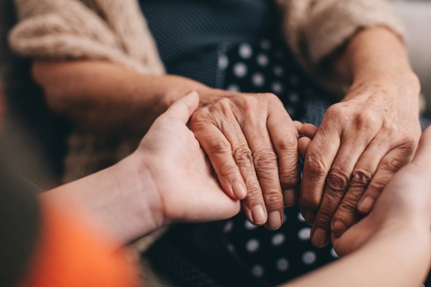
Moving more care from hospitals to communities

Slide 11
Moving more care from hospitals to communities
Information
What is the challenge?
What might this include?
What impact might it have?
People are living longer but with more complicated health conditions.
Treating people in hospital is expensive – and this is where most of the NHS budget is spent.
There are longer waiting lists for A&E, hospital treatments and mental health services.
Moving from delivering lots of care in hospitals, to delivering more care in communities (e.g. GPs, pharmacists) and in people’s homes.
More care in communities would be more suitable for people’s needs.
Fewer people going to hospital means hospitals can focus on emergency and specialist care.

Slide 12
What do we mean by healthcare that is delivered ‘in the community’?
Information
Healthcare in the community provides support to help people:
Stay healthy
Manage long-term conditions – including some scans and tests
Live independently at home
People of all ages use healthcare in the community from birth to end of life.

Slide 13
For example…
Information
A district nurse may visit a house bound patient who has recently been sent home from hospital.
They may change dressings on their wounds, assist with flushing their catheter and support them with any medication.
Under the Pharmacy First scheme, patients can get treatment for seven common conditions directly from their local pharmacy, without the need for a GP appointment.
For example, pharmacists may prescribe antibiotics if you have some types of infection.

Slide 14
Who delivers healthcare in the community and where is it delivered?
Information
It can be delivered in lots of different places…
People’s homes
Community clinics
Schools
Care homes
Hospices
Pharmacies
… and by a lot of different types of healthcare professionals
District nurses
Pharmacists
Palliative (end of life) care nurses
‘Allied health professionals’ (e.g. physiotherapists, podiatrists, speech & language therapists etc.)
Midwives
Health visitors
Healthcare assistants
GPs
Dentists
Social care workers
And the public, through carers and self management

Slide 15
Example: Virtual Wards to help people receive hospital care at home
Information
What is this service?
Virtual wards allow patients to get hospital level care, at home (including in care homes).
Patients may wear a device which monitors their heart rate, oxygen levels and skin temperature. This information is transferred to the clinical team every 15 minutes. They may be on an IV drip.
Patients are reviewed daily by the clinical team, either in person or via video call. The team can also provide tests and treatments if and when required.
Who uses the service?
Virtual wards are used to avoid admission to hospital or to support early discharge from hospital. They are most commonly used for:
Respiratory and lung conditions, such as Chronic Obstructive Pulmonary Disease (COPD)
Acute frailty for patients aged 65+
Heart failure

Slide 16
Example: Virtual Wards to help people receive hospital care at home
Information
Benefits
Considerations
Treating patients in surroundings familiar to them, with the support of friends or family or other care support nearby, can speed up their recovery and increase wellbeing.
A study has shown that virtual wards are less expensive than being in hospital, saving £2,265 per patient.
They free up space in hospitals for those who most need to be cared for in a hospital setting.
There is a need to manage digital inequality. Virtual wards require a strong Wi-Fi connection which may be lacking in rural areas.
GPs can also be kept up to date with the patient’s care.
It allows the health and care staff to deliver care flexibly. For example, work remotely or work different hours.

Slide 17
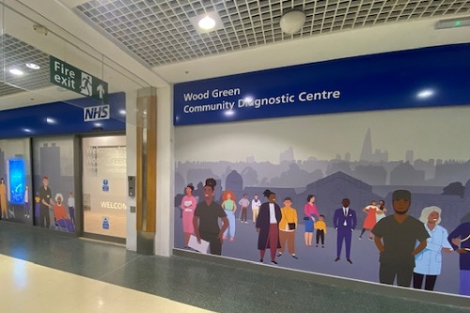
Example: Community diagnostic centres bring diagnostics closer to home
Information
What is this service?
Community diagnostic centres provide a broad range of diagnostic tests. For example, scans (e.g. MRI), tests (e.g. blood) and checks (e.g. seeing how well your kidneys are working).
They are often located away from hospitals (e.g. shopping centres), allowing people to access diagnostics closer to home.
Who uses the service?
Anyone who needs diagnostics!
Patients can be referred to community diagnostic centres via their GP or by a consultant working in a hospital.

Slide 18
Example: Community diagnostic centres bring diagnostics closer to home
Information
Benefits
Considerations
GPs can refer directly to community diagnostic centres. This can give patients quicker access to diagnostic tests, leading to earlier diagnosis and treatment.
Community diagnostic centres can make it easier to access diagnostic tests. For example, they could reduce the time and cost of travelling to hospitals by being set up in more convenient locations.
As patients won’t be going to hospitals for tests, they can increase space in hospitals to help those most in need.
Not all tests are appropriate to be delivered in community diagnostic centres.
Should community diagnostic centres offer different tests in different places to meet the needs of local populations? Or should they be the same everywhere?
Community diagnostic centres are expensive to set up.
They are only cost effective if running at full capacity.

Slide 19
Example: Ambulance triage to make sure people get the best care possible
Information
What is this service?
When paramedics have been called out, they call a hotline to a specialist healthcare professional.
They explain the situation, the patient’s background and their recommended plan.
The healthcare professional adds to the plan and helps the paramedic put it into action.
The plan means the patients get the best care for them. For example, they might receive care in their home from the paramedic, be sent to a service other than the hospital or be admitted straight to the hospital ward rather than A&E.
Who uses the service?
The service is targeted towards people over the age of 75. Lots of people in this group are admitted to A&E when an ambulance is called, even if they would rather not be.
At the moment, the ambulance crew can feel that they have no choice but to take a person to hospital because they do not know their medical history.

Slide 20
Example: Ambulance triage to make sure people get the best care possible
Information
Benefits
Considerations
People receive the best care for them.
This approach can mean that patients avoid upsetting long-waits for treatment in A&E.
It can reduce admissions to A&E, so healthcare professionals can focus on those patients with the greatest need.
There needs to be a clinician who is available for telephone triage.
Advanced Paramedic Practitioners are trained to Masters level and have the potential to treat a greater number of conditions in patients’ homes.

Slide 21
Preventing sickness, not just treating it

Slide 22
Focussing on preventing sickness, not just treating it
Information
What is the challenge?
What might this include?
What impact might it have?
More could be done to help the nation stay healthier for longer, for example:
Smoking is the cause of 25% of cancer deaths
More than half of our nation is overweight or obese
Levels of poor mental health have risen – this is now the main health related cause of people being unemployed
More screening services to identify early stages of diseases
More support for those wanting to quit smoking and prevent the development of lung cancer
Weight management programmes to encourage people to live healthier lifestyles and prevent obesity
Preventing ill health will cost the NHS less in the long-term
People will also live healthier lives for longer and be able to work and engage in society for longer

Slide 23
What keeps us in good health?
Information
Wider factors that affect health. These are the social, economic and environmental factors which can affect our health and wellbeing.
It might include the quality of our homes, how much money we have, access to healthy food and availability of parks and green spaces.
Primary prevention can include action the Government (national or local) takes on our collective behalf to create an environment where it’s easier to be healthy. This may include creating a smoke-free Britain and tackling the drivers of obesity or alcohol misuse.
Secondary prevention is action the health and care system can take to prevent or delay the progression of disease through our lifetime, focused on individuals with their consent.

Slide 24
When we talk about prevention we mean:
Information
When NHS staff check if you have risks of disease or if you already have a disease and take action (with your agreement) to help keep you well. For example:
Your age may mean you are more likely to get some cancers, so you can be screened
Your weight may mean you’re more likely to develop diabetes
You could protect yourself from diseases you catch from others through vaccines (e.g. measles, shingles)
The NHS may do different things to reduce these risks and keep you well.
People can decide whether they do or do not want to take them up.
If you already have a health condition that may mean you’re more likely to get some viruses
Your cholesterol levels may mean you are more likely to get heart disease or have a stroke
Your family history may indicate you’re more likely to experience a certain condition

Slide 25
Preventing sickness, not just treating it
Information
Here are some different ways that the NHS helps to prevent sickness…
Mental health support teams
National child measurement programme
What is it?
What is it?
Mental health support teams provide one-to-one and group conversations and early support for mental health issues in schools and colleges in England.
Children are weighed and measured in school. This information helps to build a picture about how children are growing and engage with parents.
What do we need to know?
What do we need to know?
Early intervention can prevent mental health issues from escalating. This can reduce the knock-on effects of mental ill health in adulthood.
Early intervention can save money.
If a child is above a healthy weight, they’re more likely to be above a healthy weight as an adult. This can lead to health problems later in life.
Support can be delivered early to help.
Parents can withdraw their child if they do not want them to be measured.
Information from the programme can be used to plan better health and leisure services.

Slide 26
Preventing sickness, not just treating it
Information
Here are some different ways that the NHS helps to prevent sickness…
Cervical Screening
The HPV vaccine
What is it?
What is it?
Cervical screening, which used to be called smear test, is a test to look for HPV. It’s offered to women and people with a cervix aged 25 – 64.
The HPV vaccine helps people protect against human papillomavirus (HPV). Some types of HPV increase the risk of certain types of cancer.
What do we need to know?
What do we need to know?
At the moment, people are invited to an appointment with a nurse for the test. But the NHS is trialling a ‘do it yourself’ test that can be done at home.
It saves around 5,000 lives every year by detecting early signs, leading to earlier diagnosis and treatment.
Early detection saves the NHS money.
Not everyone accepts the screening offer.
All children aged 12 to 13 are offered the HPV vaccine. Most children will receive the vaccine in schools. Others who are at higher risk of HPV may receive it in a sexual health or HIV clinic.
The vaccine is effective: it has been shown to reduce cervical cancer rates by almost 90% in women.
Not all parents consent for their child to have the vaccine.

Slide 27
Preventing sickness, not just treating it
Information
Here are some different ways that the NHS helps to prevent sickness…
Weight loss jabs (e.g. Wegovy)
What is it?
A weight loss medication that works by making you feel fuller and less hungry. It is prescribed by healthcare professionals if diet and exercise have not helped someone lose weight.
What do we need to know?
It is very effective.
By helping people lose weight, it can prevent illness: obesity can cause cancer, Type 2 diabetes and other conditions.
It is expensive, but obesity is expensive for the NHS.
Some say it has benefits beyond weight loss, e.g. helping people back to work.

Slide 28
Thank you for taking part
We really appreciate your contribution

