Slide 1
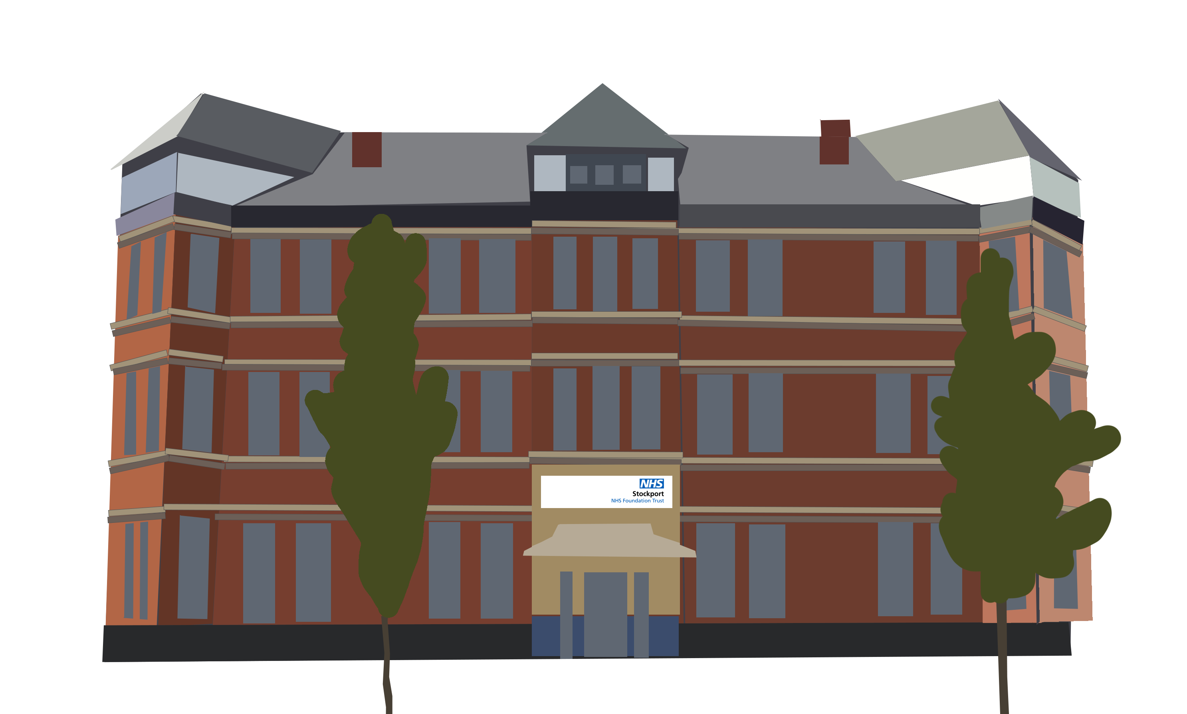
Summary Operational Plan 2025/26
Our operational plans focus on improvements for our patients and staff as we work to deliver the national priorities.
Reducing Waiting Times
Improving Emergency Care
Improving Quality
Reduce the waiting list by 6,657
Nobody waiting over 52 weeks
65% seen within 18 weeks
67% for first appointment
85% day case rate
85% theatre utilisation
<5% diagnostics over 6 weeks
78% seen in ED within 4 hrs by Mar 2026
Reduce 12 hour waits to 10.5%
Average ambulance handover 27 mins – none over 45 minutes
Over 70% urgent community responses within 2 hours
Surpass national cancer standards
80% diagnosed in 28 days
75% seen in 62 days
91% treated in 31 days
Reduce length of stay
£35.4m Capital Programme
Improving Productivity
Supporting our Workforce
Reducing Inequality
Balanced financial position
Deliver £29.2m Trust Efficiency Programme
Cap agency spend at £6.3m
Cap bank spend at £30.9m
DNA rate target of less 6.3%
Increase PIFU rates to 5%
Improve staff retention to 11.5%
Reduce sickness rates to 5.5%
1% reduction in WTEs via Trust Efficiency Programme
11% reduction in bank staff
31% reduction in agency staff
80% virtual ward occupancy
No community waits over 52 weeks
Stockport NHS Foundation Trust
Operational Plan 2025/26

